Slide 1


Comparison Learning Vector Quantization and Naïve Bayes Algorithm in Airline Passenger Satisfaction
NIKODEMUS GALIH CANDRA WICAKSONO - 18.K1.0082

Slide 2
Background Problem
Digital data can store a lot of data
There are about 130000 airline passenger satisfaction data
Using the Naive Bayes algorithm and the Learning Vector Quantization algorithm

Slide 3
Problem Formulation
Can the Naïve Bayes algorithm classify airline passenger satisfaction data?
Can the Learning Vector Quantization algorithm classify airline passenger satisfaction data?
Based on the level of accuracy, which algorithm is better in classifying passenger satisfaction data?

Slide 4
Roadmap
NAÏVE BAYES
Implementing the algorithm with 5 different tests
CALCULATING ACCURACY
Calculating the accuracy value of each test for both algorithms
GET DATA
Data taken from the Kaggle website
1
3
5
2
4
PREPROCESSING DATA
Deleting data and transforming data
LEARNING VECTOR QUANTIZATION (LVQ)
Implementing the algorithm with 5 different tests

Slide 5
129,879
1
Airline Passenger Satisfaction Data
22
Input Column
Label Column
Get from
https://www.kaggle.com/binaryjoker/airline-passenger-satisfaction

Slide 6
129,879
1,393
129,486
Total Data Before Pre-processing
Deleted Data
Final Total Data!

Slide 7
Transforming data
Attribute Name | Before | After
Gender | “Female” and “Male” | “0” and “1”
Customer Type | “Loyal Customer” and “Disloyal Customer” | “0” and “1”
Age | Numbers from 7 to 85 | “0” (<28), ”1” (<52) and “2” (>=52)
Type of Travel | “Business travel” and “Personal Travel” | “0” and “1”
Customer Class | “Business”, “Eco” and “Eco Plus” | “0”, “1”, and “2”
Flight Distance | Numbers from 31 to 4983 | “0” (<=414), “1” (<=1744), “2” (>1744)
Departure Delay | Numbers from 0 to 1592 | “0” (<=12) and “1” (>12)
Arrival Delay | Numbers from 0 to 1584 | “0” (<=13) and “1” (>13)
Satisfaction | “Neutral or dissatisfied” and “Satisfied” | “0” and “1”

Slide 8
Distribution of Training and Testing Data
Test | Training Data | Testing Data
I | 90% | 10%
II | 75% | 25%
III | 50% | 50%
IV | 25% | 75%
V | 10% | 100%

Slide 9

$$\begin{aligned}Accuracy=\frac{TP+TN}{TP+FN+FP+TN} x 100\%\end{aligned}$$
9

Slide 10
TRAINING DATA
id | Gender | Customer Type | Satisfaction
1 | 1 | 1 | 0
2 | 1 | 0 | 0
3 | 0 | 1 | 1
4 | 0 | 1 | 0
5 | 1 | 1 | 1
TESTING DATA
id | Gender | Customer Type | Satisfaction
1 | 1 | 1 | 0

Slide 11
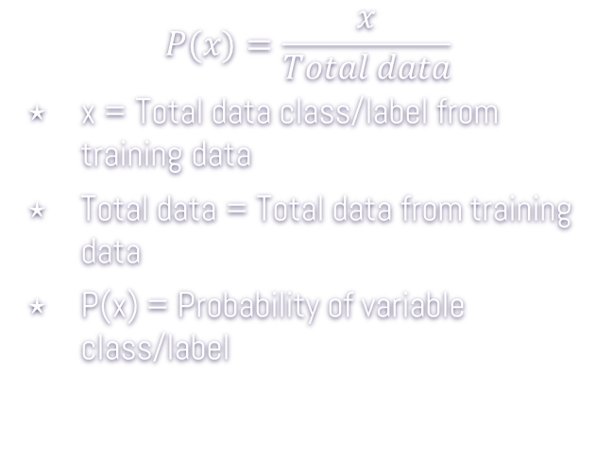
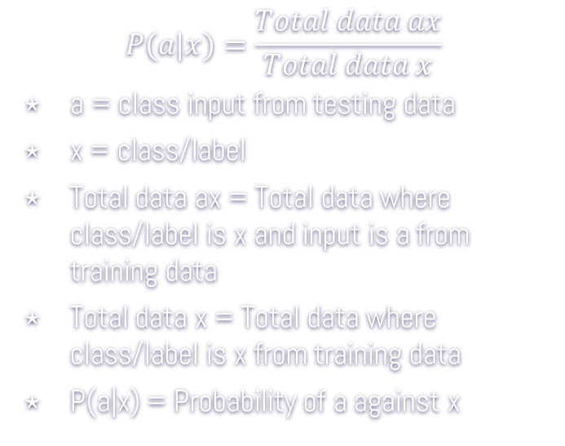
NAÏVE BAYES
$$P(x)=\frac{x}{Total data}$$
x = Total data class/label from training data
Total data = Total data from training data
P(x) = Probability of variable class/label
$$P(a|x)=\frac{Total data ax}{Total data x}$$
a = class input from testing data
x = class/label
Total data ax = Total data where class/label is x and input is a from training data
Total data x = Total data where class/label is x from training data
P(a|x) = Probability of a against x

Slide 12
Learning Vector Quantization (LVQ) Initialization
Weight (W)
Epoch
MaxEpoch
Learning Rate /
Alpha (α)
Minimum error
(Eps)

Slide 13
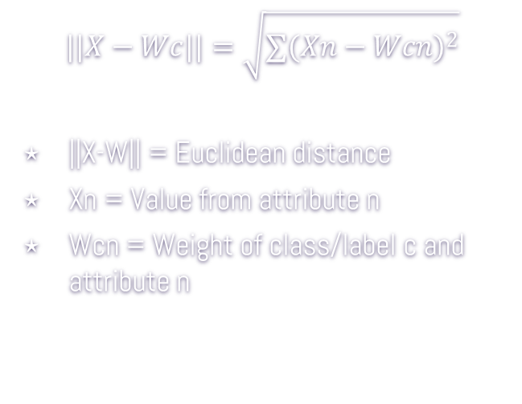
Learning Vector Quantization (LVQ)
$$||X−Wc||=\sqrt{{∑(Xn−Wcn)}^{2}}$$
||X-W|| = Euclidean distance
Xn = Value from attribute n
Wcn = Weight of class/label c and attribute n
If J= T then W_{j}` = W_{j} + α (X - W_{j})
If J ≠ T then W_{j}` = W_{j} – α (X - W_{j})
T=Target
W_{j} = Weight class j
α = Learning ratio
j = prediction class
X = data value
W_{n} = Weight index n

Slide 14
TRAINING DATA
id | Gender | Customer Type | Satisfaction
1 | 1 | 1 | 0
2 | 1 | 0 | 0
3 | 0 | 1 | 1
4 | 0 | 1 | 0
5 | 1 | 1 | 1
TESTING DATA
id | Gender | Customer Type | Satisfaction
1 | 1 | 1 | 0

Slide 15
Results Naïve Bayes
Test | TP | TN | FP | FN | Tnull | Fnull | Accuracy
I | 4992 | 6485 | 756 | 716 | 0 | 0 | 88.63%
II | 12438 | 1822 | 1822 | 1735 | 0 | 0 | 89.01%
III | 24728 | 3565 | 3565 | 3433 | 0 | 0 | 89.18%
IV | 37089 | 5427 | 5427 | 5039 | 1 | 0 | 89.22%
V | 44629 | 6444 | 6444 | 5965 | 1 | 10 | 89.34%
Average = 89,08%
Naïve bayes ± 3days 3hours

Slide 16
Results LVQ Alpha 0.9 and
Eps 0.0000001, 0.0001, 0.01
Test | TP | TN | FP | FN | Accuracy
I | 0 | 7421 | 0 | 5708 | 55.92%
II | 0 | 18198 | 0 | 14173 | 56.22%
III | 0 | 36572 | 0 | 28171 | 56.49%
IV | 0 | 54985 | 0 | 42129 | 56.62%
V | 0 | 65942 | 0 | 50595 | 56.58%
Average = 56,37%
LVQ ± 30 Minutes

Slide 17
Results LVQ Alpha 0.1 and
Eps 0.0000001
Test | TP | TN | FP | FN | Accuracy
I | 3802 | 6406 | 835 | 1906 | 78.83%
II | 10893 | 14777 | 3421 | 3280 | 79.30%
III | 22117 | 28842 | 7730 | 6054 | 79.71%
IV | 34469 | 40371 | 14614 | 7660 | 77.06%
V | 42421 | 47930 | 18012 | 8174 | 77.53%
Average = 78,49%

Slide 18
Results LVQ Alpha 0.1 and
Eps 0.0001
Test | TP | TN | FP | FN | Accuracy
I | 4405 | 5841 | 1400 | 1303 | 79.13%
II | 10963 | 14652 | 3546 | 3210 | 79.13%
III | 21824 | 29496 | 7076 | 6347 | 79.27%
IV | 33133 | 43881 | 11104 | 8996 | 79.30%
V | 39977 | 52072 | 13870 | 10618 | 78.99%
Average = 79,16%

Slide 19
Results LVQ Alpha 0.1 and
Eps 0.01
Test | TP | TN | FP | FN | Accuracy
I | 4412 | 5904 | 1337 | 1296 | 79.67%
II | 9998 | 15383 | 2815 | 4175 | 78.41%
III | 21823 | 29752 | 6820 | 6348 | 79.66%
IV | 31784 | 45028 | 9957 | 10345 | 79.09%
V | 38662 | 54703 | 11239 | 11933 | 80.12%
Average = 79,39%

Slide 20
Results LVQ Alpha 0.01 and
Eps 0.0000001
Test | TP | TN | FP | FN | Accuracy
I | 4252 | 6041 | 1200 | 1456 | 79.49%
II | 10910 | 14788 | 3410 | 3263 | 79.39%
III | 21900 | 29310 | 7262 | 6271 | 79.10%
IV | 33299 | 43552 | 11433 | 8830 | 79.13%
V | 39884 | 51750 | 14192 | 10711 | 78.63%
Average = 79,15%

Slide 21
Results LVQ Alpha 0.01 and
Eps 0.0001
Test | TP | TN | FP | FN | Accuracy
I | 4414 | 5825 | 1416 | 1294 | 79.07%
II | 10984 | 14616 | 3582 | 3189 | 79.08%
III | 21869 | 29452 | 7120 | 6302 | 79.27%
IV | 32772 | 44270 | 10715 | 9357 | 79.33%
V | 39688 | 52322 | 13620 | 10907 | 78.95%
Average = 79,14%

Slide 22
Results LVQ Alpha 0.05 and
Eps 0.0000001
Test | TP | TN | FP | FN | Accuracy
I | 3797 | 6522 | 719 | 1911 | 79.69%
II | 10809 | 14977 | 3221 | 3364 | 79.66%
III | 21713 | 29818 | 6754 | 6458 | 79.59%
IV | 33943 | 41848 | 13137 | 8186 | 78.04%
V | 40709 | 51609 | 14333 | 9886 | 79.22%
Average = 79,24%

Slide 23
Results LVQ Alpha 0.05 and
Eps 0.0001
Test | TP | TN | FP | FN | Accuracy
I | 4407 | 5843 | 1398 | 1301 | 79.16%
II | 10964 | 14657 | 3541 | 3209 | 79.15%
III | 21824 | 29522 | 7050 | 6347 | 79.31%
IV | 32969 | 44054 | 10931 | 9160 | 79.31%
V | 39887 | 51730 | 14212 | 10708 | 78.62%
Average = 79,11%

Slide 24
CONCLUSION
1. Naive Bayes can be used to classify airline passenger satisfaction. It is proven that the Naive Bayes algorithm can be implemented for customer satisfaction data obtained through Kaggle.
2. Learning Vector Quantization can also classify airline passenger satisfaction. This is because this algorithm can be implemented on the same data to implement Naive Bayes.
3. Of the two algorithms, Naive Bayes is better at classifying airline passenger satisfaction than Learning Vector Quantization. This is based on the average accuracy of the two algorithms. Naive Bayes has an average accuracy of 89.076% while the LVQ is 79.852%.

Slide 25
Thanks!

Slide 26
Credits
Special thanks to all the people who made and released these awesome resources for free:
Presentation template by SlidesCarnival
Photographs by Unsplash

